Slide 1
AIRCRAFT ACCIDENTS ANALYSIS
Analysis of Aircraft Safety Performance
ANALYST: MOKAYA RICHARD KEOYE

Slide 2
OVERVIEW
We are entering the aviation industry by acquiring aircraft for commercial and private operations. This analysis focuses on identifying the safest aircraft to minimize operational risks.
The primary challenge in selecting an aircraft is evaluating its historical safety performance to minimize the risk of accidents.

Slide 3
BUSINESS UNDERSTANDING
Objective
Minimize the risk of accidents through data-driven aircraft selection, ensuring operational safety and compliance with industry standards.
Stakeholders:
Decision-makers in the aviation industry.

Slide 4
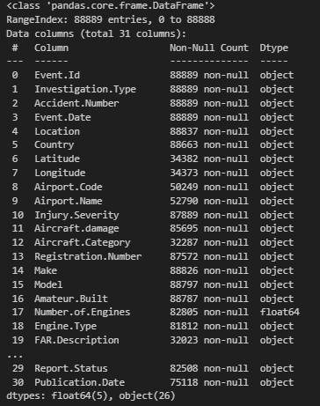
DATA UNDERSTANDING
Description of dataset
The dataset has:
82,474 rows (entries)
31 columns, including:
6 float variables
26 object data types
Source of data: https://www.kaggle.com/datasets/khsamaha/aviation-accident-database-synopses

Slide 5
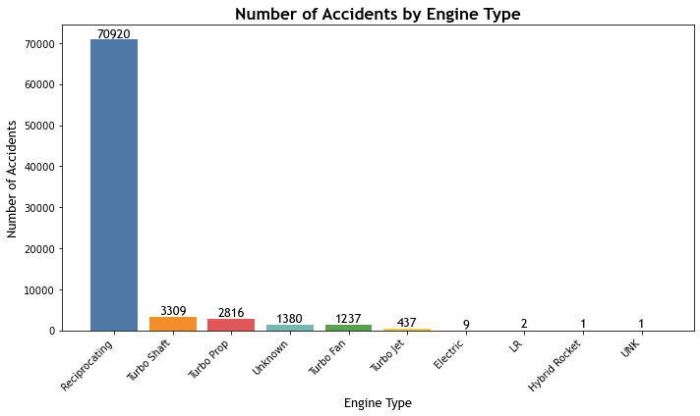
DATA ANALYSIS
Reciprocating engines are involved in most accidents

Slide 6
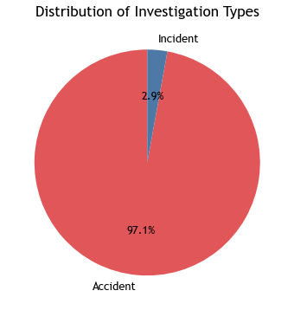
Investigation Types
Most Investigation types are classified as accidents, indicating a focus area.

Slide 7
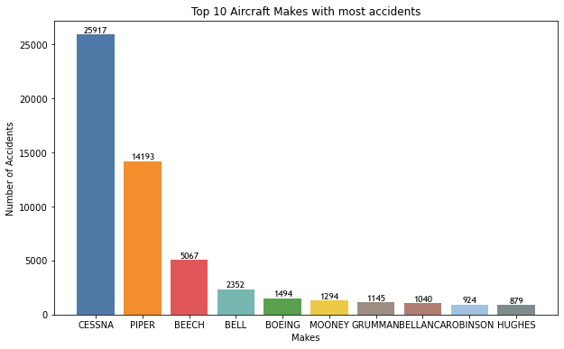
Number of Accidents by Aircraft Make
CESSNA and PIPER are the most frequently involved in accidents.
BOEING and BELL, while having fewer accidents compared to CESSNA and PIPER, still have significant numbers.

Slide 8
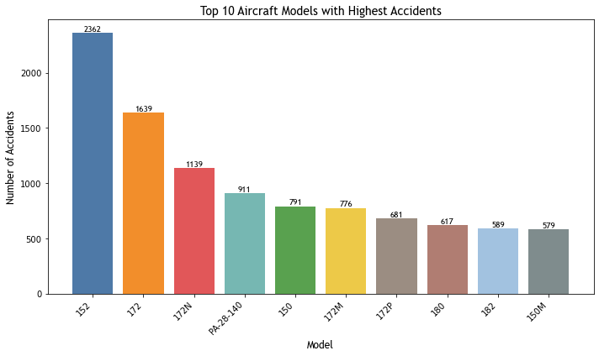
Number of Accidents by Aircraft Models
152 and 172 are the most frequently involved models in accidents, reflecting their high usage.
PA-28-140 and 150 also show notable accident rates.

Slide 9
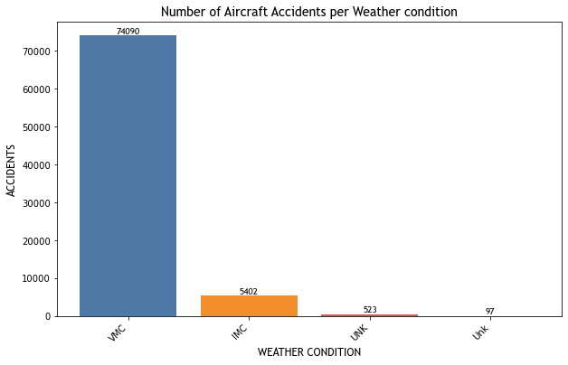
Number of Accidents by Weather conditions
VMC weather conditions exhibit huge accidents as compared to IMC and other weather condition categories

Slide 10
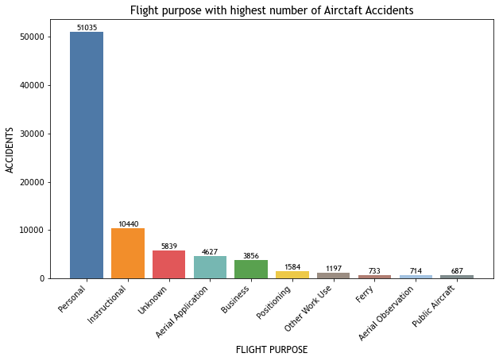
Accidents by purpose of flight
Aircrafts used for Personal reasons experienced a huge number of accidents i.e. 51,035 as compared to those used for business purpose which experienced 3,856 accidents

Slide 11
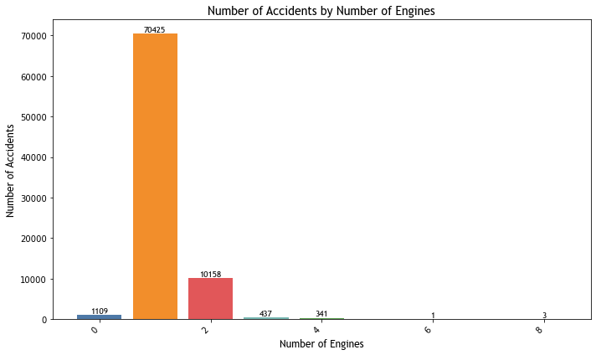
Accidents by number of engines
Aircrafts with 1 engine experienced huge number of accidents i.e., 70,425 as compared with those with 2 engines or more.

Slide 12
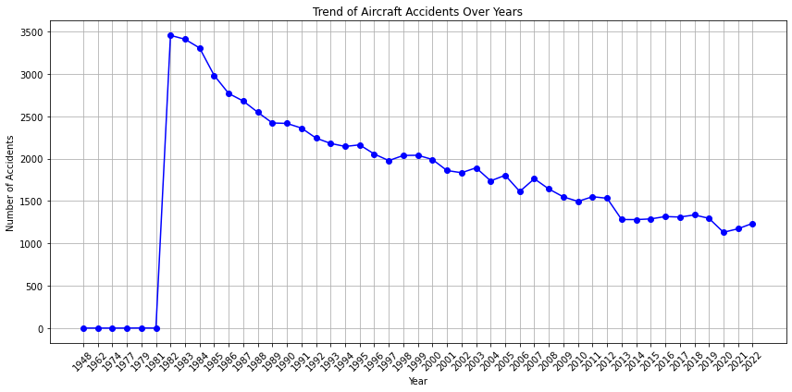
Trend of Aircraft Accidents over years

Slide 13
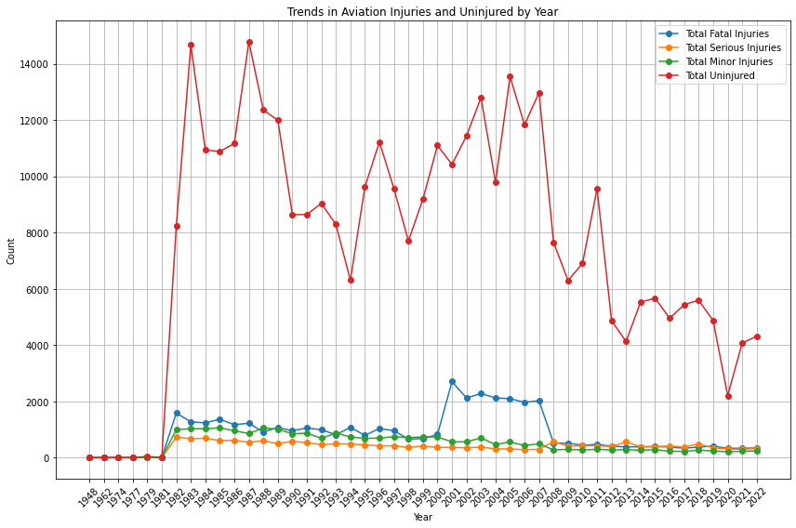
Trend Analysis of various injuries

Slide 14
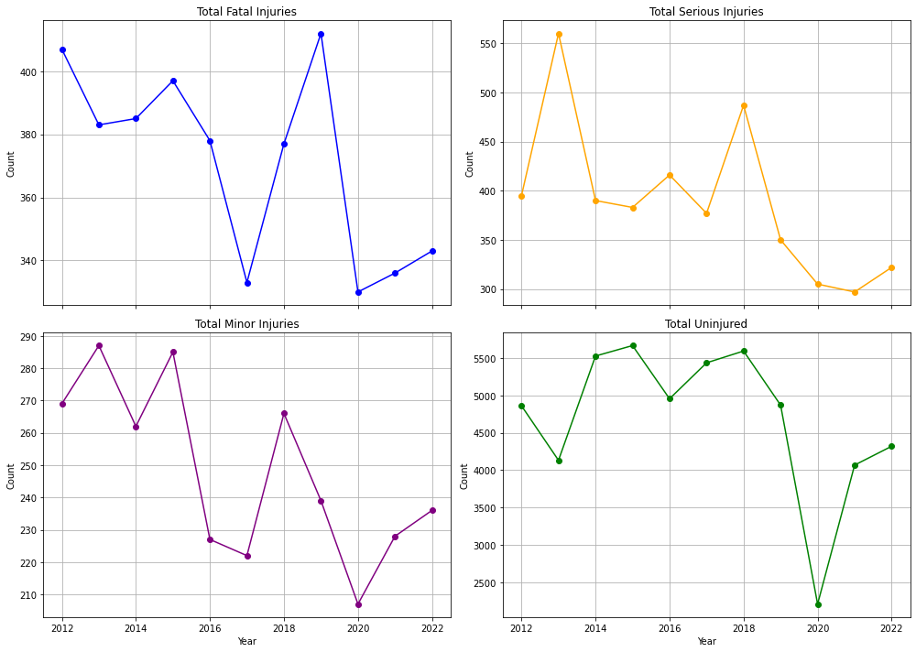
Trend Analysis of injuries for the last 10 years

Slide 15
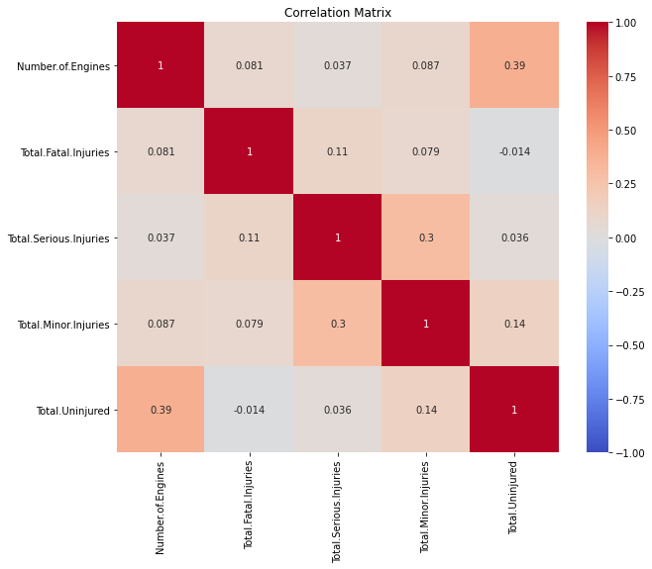
Heatmap
Number of Engines and
Total Uninjured (0.39)-Imply moderate +ve correlation i.e., Aircraft with more engines may provide better safety
Total Serious Injuries and Total Minor Injuries (0.30)-accidents with a higher number of serious injuries tend to also involve more minor injuries
Total Fatal Injuries with other injury categories, have weak positive correlations (close to 0) i.e. No relationship

Slide 16
Recommendations
Opt for Dual-Engine Aircraft: Choose aircraft with at least 2 engines, as they generally have lower accident rates due to engine redundancy.
Ensure Weather Adaptability: Select aircraft capable of operating in both VMC and IMC to enhance safety across diverse weather conditions.
Evaluate Regional Risk: Be cautious with aircraft operating in high-accident areas like Anchorage, Alaska. Consider alternative routes to mitigate risk.
Prioritize Business Aircraft: Favor aircraft used for business purposes over personal flights, as they typically adhere to stricter safety and operational standards.
Avoid High-Accident Makes: Consider aircraft from manufacturers with fewer accidents. For example, MOONEY and ROBINSON have lower accident rates compared to CESSNA and PIPER.
Select Safer Models: opt for aircraft models with fewer reported accidents. For instance, models like 150M have better safety records compared to the 152 and 172.
Choose Newer Aircraft: Prefer newer models or those with recent safety updates, as accident rates have generally decreased over time, reflecting improvements in aviation safety.

Slide 17
Next Steps
Action Items: Review aircraft models, conduct further analysis.
Further Research: Explore new technologies and safety improvements.

Slide 18
THANK YOU
***Questions ****
Contacts: +254707751916
Email: rmokaya1@gmail.com
LinkedIn: https://www.linkedin.com/in/mokaya-keoye

